Slide 2
SQL MINER
Automated Extraction of SQL Queries from Code Repositories
Presented By – Shashank Mourya Pippari
May 2025

Slide 3
Introduction
Why we need to extract SQL from code?
Common challenges in locating SQL in large codebases
Goal: Automate and categorize SQL detection for migration or auditing from code repositories.

Slide 4
Key Features
Pattern-based SQL Extraction:
Uses regular expressions to identify SQL queries and stored procedure calls.
Decompilation:
Automatically decompiles Java .class files using CFR.
Archive Extraction:
Extracts .jar/.zip files to scan their contents.
Excel Reporting:
Saves all findings in a structured Excel file.

Slide 5
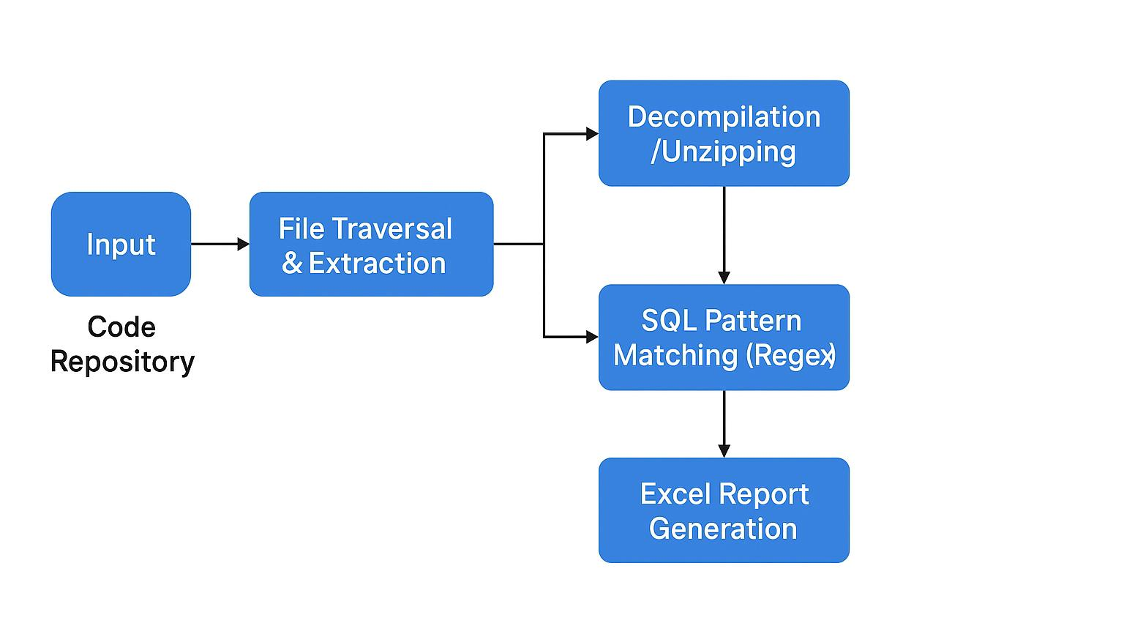
Architecture / Workflow

Slide 6
Tech Stack
Technology
Python 3- Core language for scripting and automation.
CFR Java Decompiler- External tool to decompile .class files to Java source.
Microsoft Excel- For reporting and analysis of extracted SQL queries.
Python Modules
re- Regular expressions for pattern-based SQL extraction.
zipfile- Extracts .jar archives to access embedded files.
subprocess-Runs external tools (like the Java decompiler) from Python.
os- Directory traversal and file handling.
pandas- Organizes, sorts, and exports results to Excel.
openpyxl- Reads and writes Excel files.
datetime- Adds timestamps to results.

Slide 7
Regex Patterns
Sample regex patterns for pattern matching. 1. Native SQL:
r"(?i)\bSELECT\b\s+.*?\bFROM\b\s+.*?;", #Matches Select statement
r"(?i)\bINSERT\b\s+INTO\b\s+.*?\bVALUES\b\s*\(.*?\);“ #Matches Insert
r"(?i)\bUPDATE\b\s+.*?;", #Matches Update
r"(?i)\bDELETE\b\s+FROM\b\s+.*?;“ #Matches Delete
2.Stored Procedures:
r"(?i)\bEXEC\b\s+.*?;", # Matches EXEC keyword
` r"(?i)\bCALL\b\s+.*?;", # Matches CALL keyword
r"(?i)\bPROC\b\s+.*?;", # Matches PROC keyword
r"(?i)\bEXECUTE\b\s+.*?;"

Slide 8
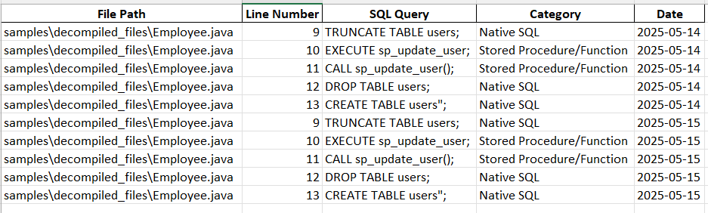
Sample Output
Columns: File Path, Line Number, SQL Query, Category, Date
Sorted for better readability

Slide 9
Why It Matters
Updatable regex patterns for different SQL syntaxes.
Saves manual effort in code review.
Finds embedded SQL for security and migration projects.
Works on any files
Easy to extend for other patterns or languages.
Enables better documentation and planning.

Slide 10
Future Enhancements
Add support for more languages (e.g., Python, Scala)
Web UI for visualizing results
Enhanced SQL parsing for accuracy

Slide 11


